Slide 1

MATH 285 Week 8
DI 2
Midterm Review

Slide 2
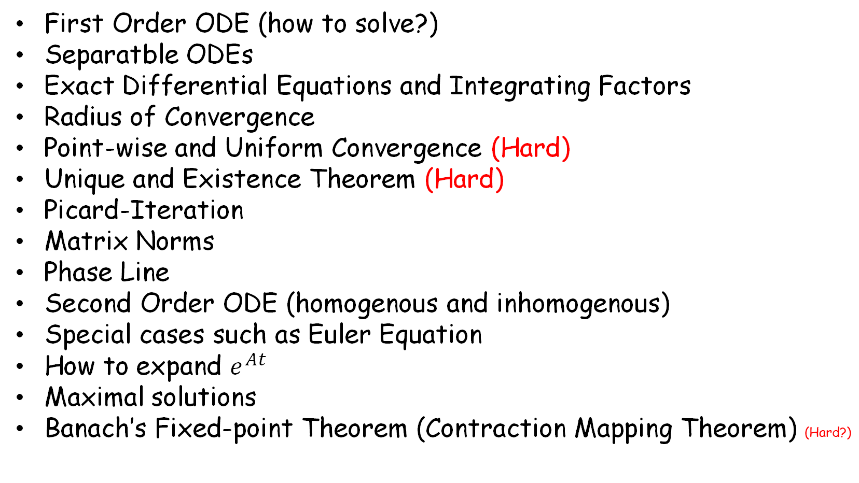
Things you should know
First Order ODE (how to solve?)
Separatble ODEs
Exact Differential Equations and Integrating Factors
Radius of Convergence
Point-wise and Uniform Convergence (Hard)
Unique and Existence Theorem (Hard)
Picard-Iteration
Matrix Norms
Phase Line
Second Order ODE (homogenous and inhomogenous)
Special cases such as Euler Equation
How to expand $e^{At}$
Maximal solutions
Banach’s Fixed-point Theorem (Contraction Mapping Theorem) (Hard?)

Slide 3
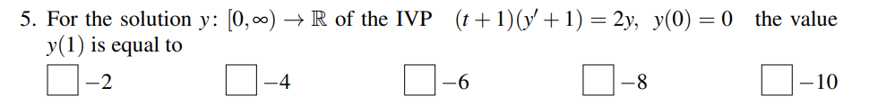
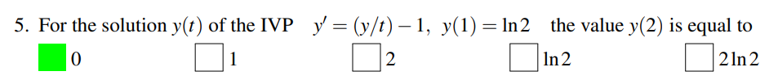
First Order ODE (how to solve?)

Slide 4
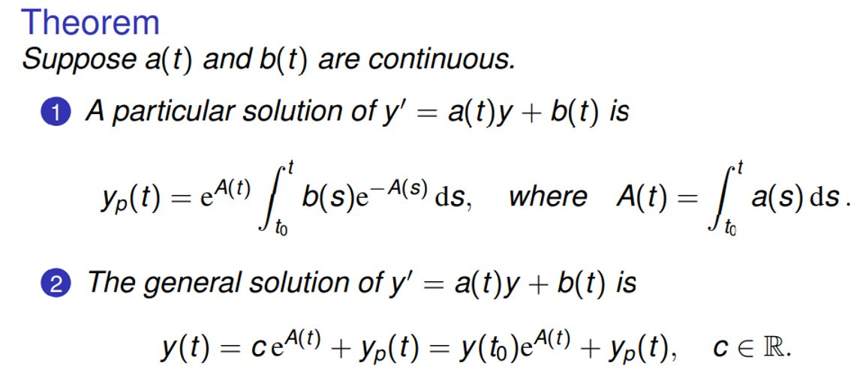

Slide 5
Separatble ODEs

Slide 6

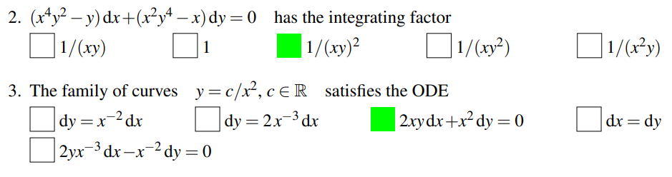
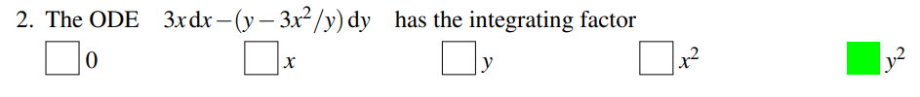
Exact Differential Equations and Integrating Factors

Slide 7

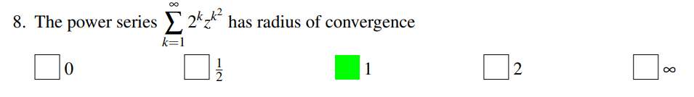
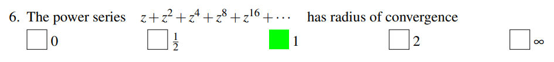
Radius of Convergence

Slide 8
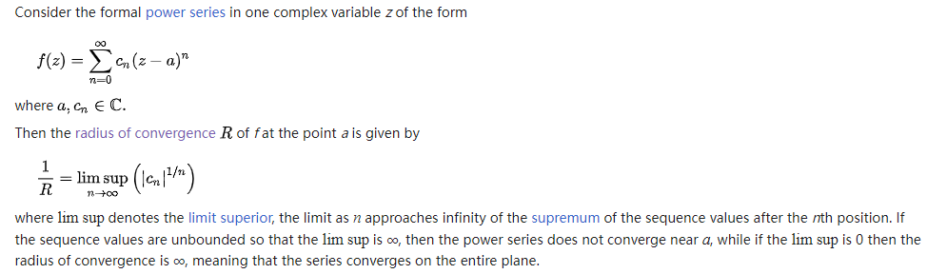
Cauchy-Hadamard formula

Slide 9
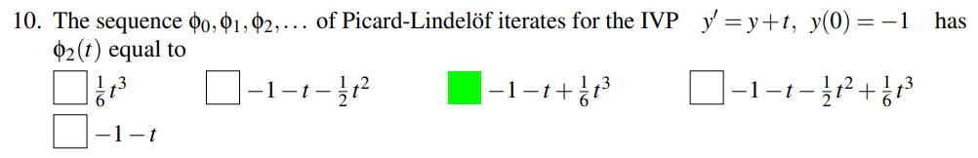
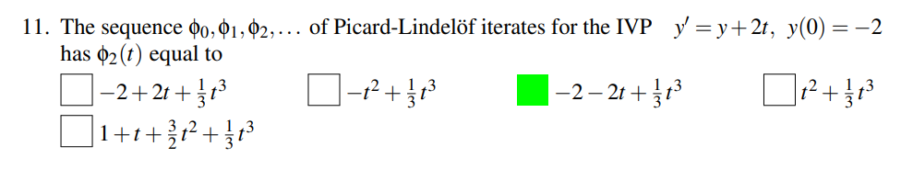
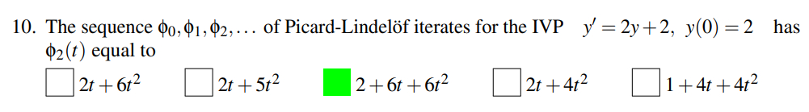
Picard-Iteration

Slide 10
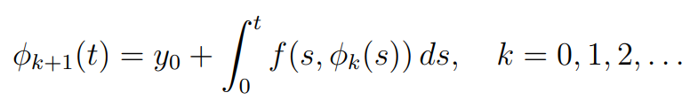
Picard-Lindelöf iteration (The method of successive approximations)

Slide 11
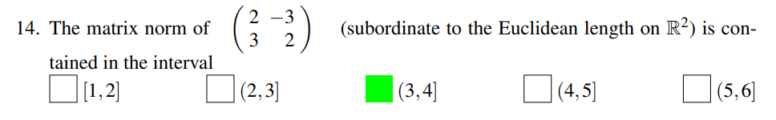
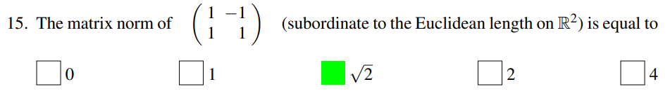
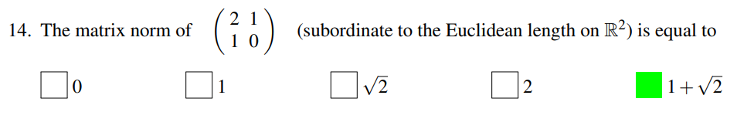
Matrix Norms

Slide 12
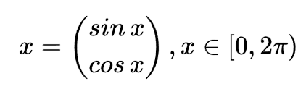


Matrix Norms and Frobenius norms
For a matrice A, the norm of A is
Let
is more simple. (Root of the sum of the squares)

Slide 13
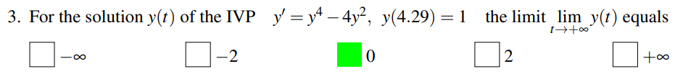
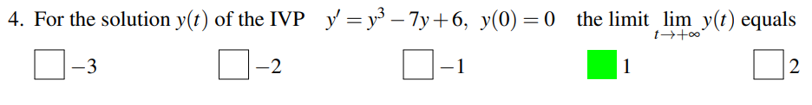
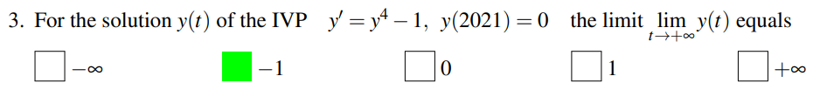
Phase Line

Slide 14
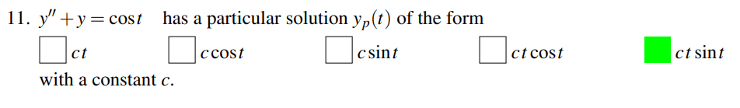
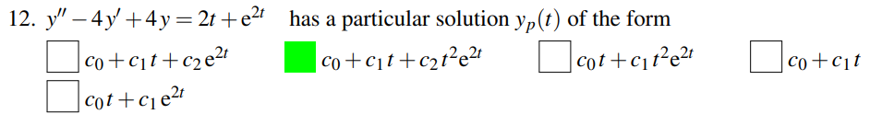
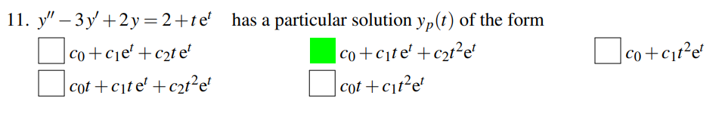
Second Order ODE (homogenous and inhomogenous)
Careful with C!

Slide 15
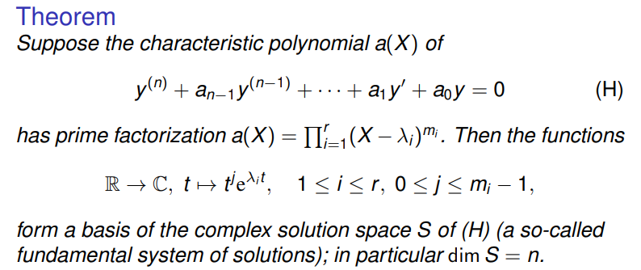
Second-order (or Higher) Ordinary Differential Equation

Slide 16
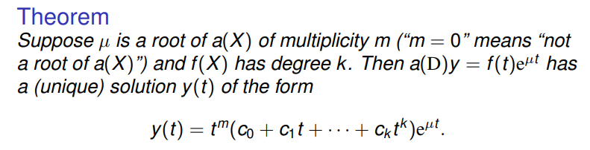
Inhomogeneous Case

Slide 17
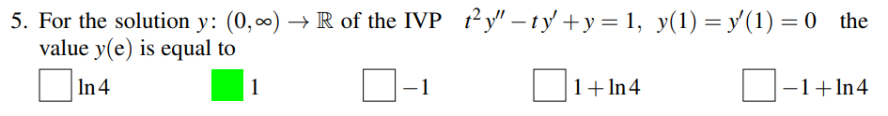
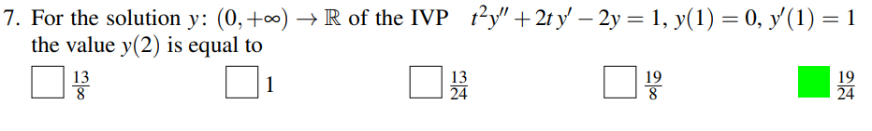
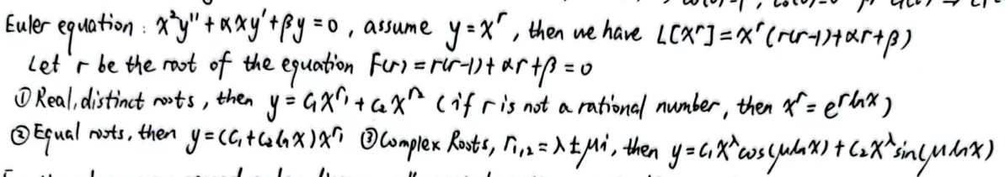
Special cases such as Euler Equation

Slide 18
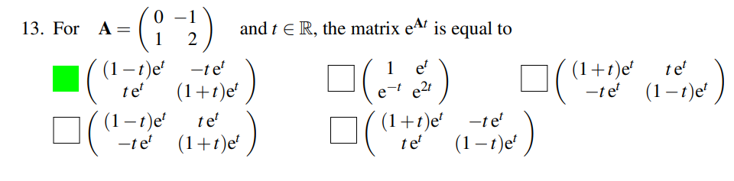
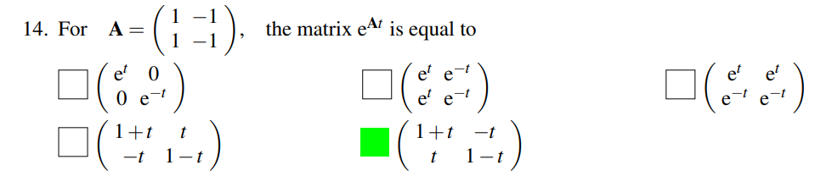
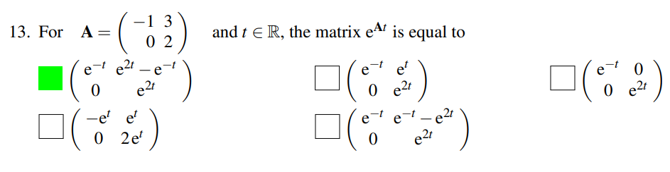
How to expand $e^{At}$

Slide 19
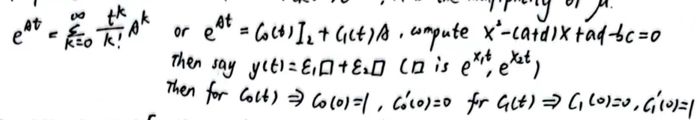
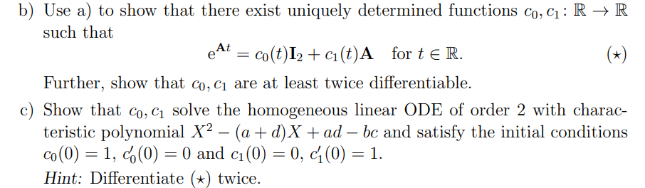
See homework 8 (homework 7 for MATH 286 ) for proof

Slide 20
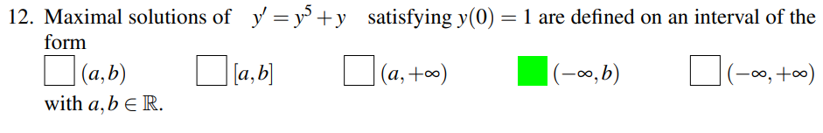
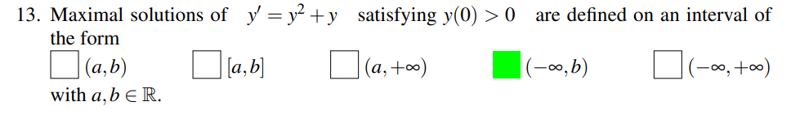
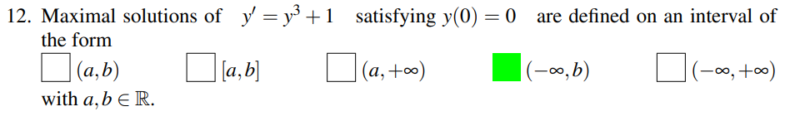
Maximal solutions

Slide 21
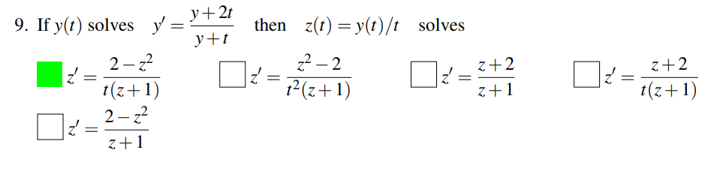
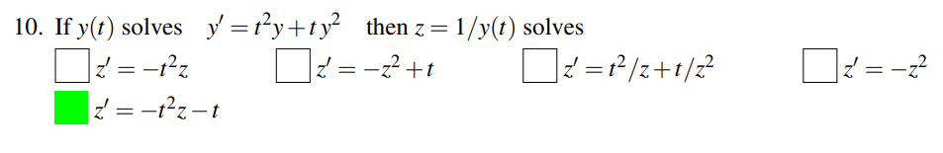
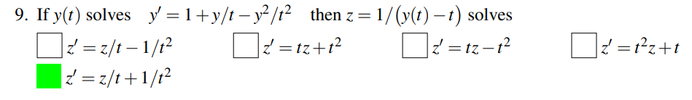
Some trivial but not hard staff (maybe?)

Slide 22
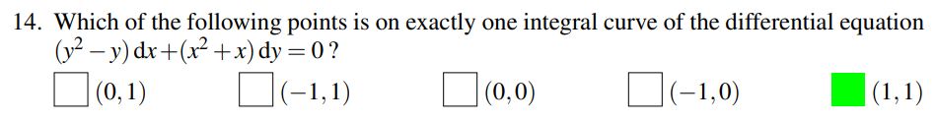
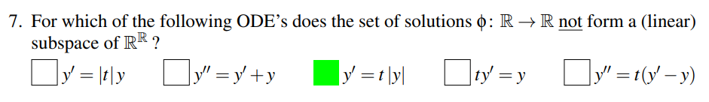
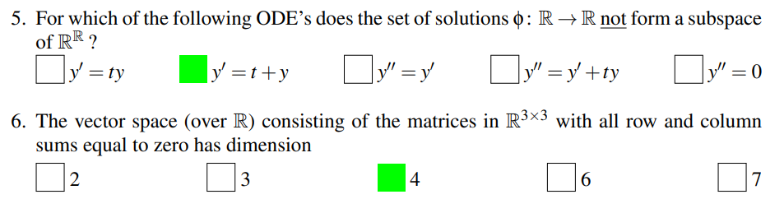
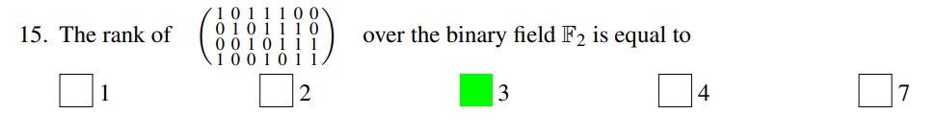

Slide 23
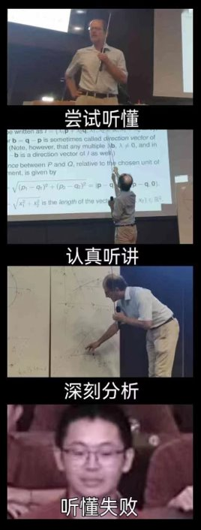
Now let’s dive into some harder stuff

Slide 24
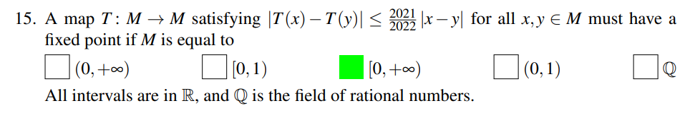

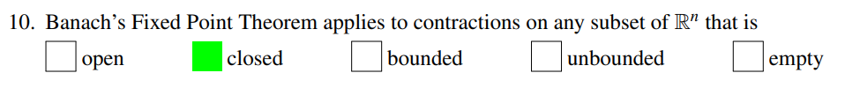
Banach’s Fixed-point Theorem (Contraction Mapping Theorem) (Hard?)

Slide 25
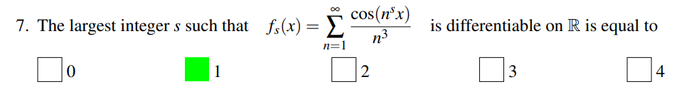

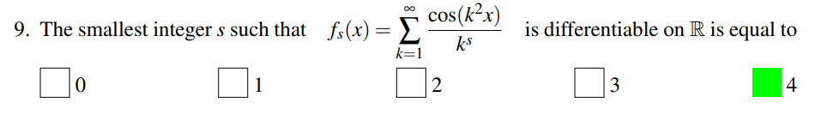
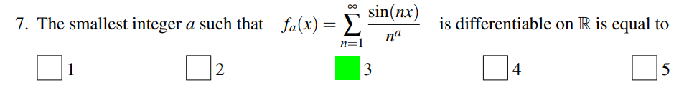
Point-wise and Uniform Convergence (Hard)
(Easy part)

Slide 26
Recall that...

Slide 27
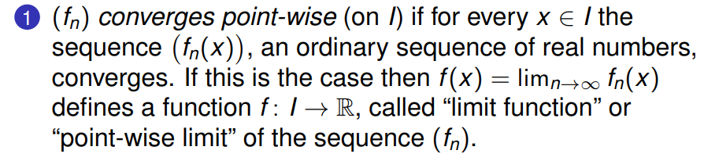


Uniform Convergence and Point-wise Convergence
Uniform Convergence Point-wise Convergence
https://www.bilibili.com/video/BV1hh41127Js

Slide 28




(Well)

Slide 29
For the most challenging part of the midterm:

Slide 30


Lipschitz Condition

Slide 31


The Uniqueness and Existence Theorem

Slide 32



Unique and Existence Theorem (Hard, I suggest skip this first)

Slide 33



Slide 34

And this:
Good Luck!

